Slide 1


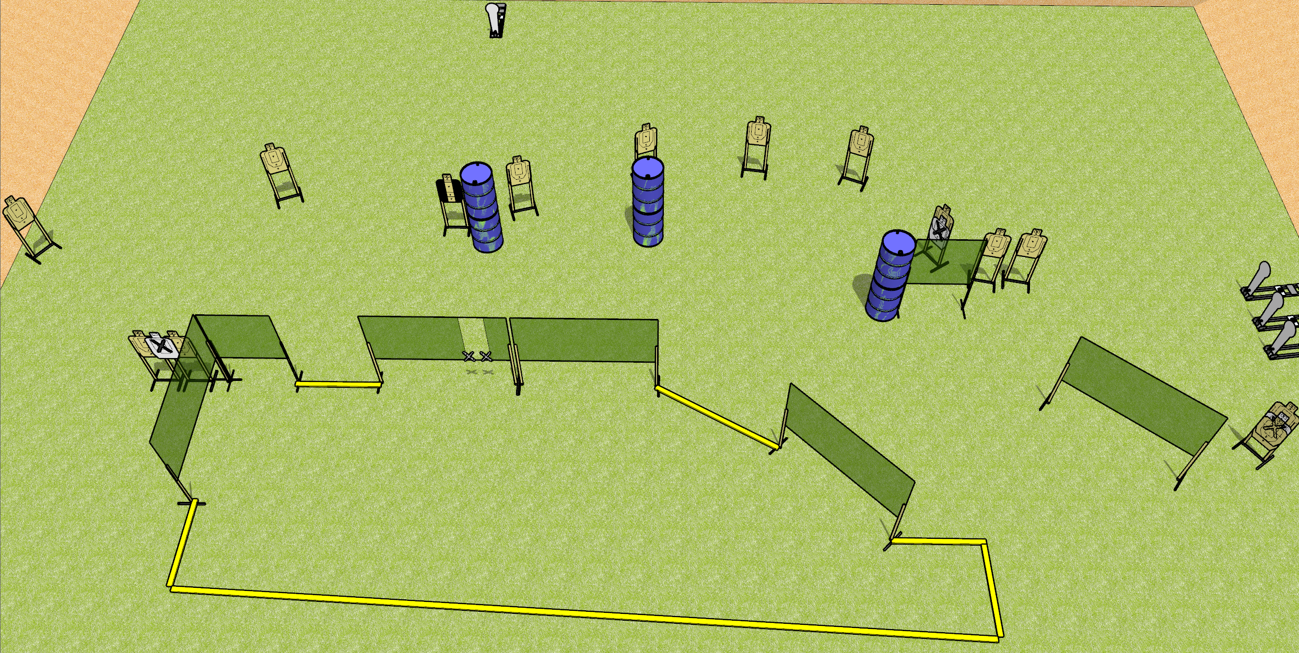
 | Dothan Gun Club – USPSA Match Spoiled Course Designer : Drew Coleman
START POSITION : At the port, palms touching the inside edges of the port. PCC muzzle touching inside edge.
GUN READY CONDITION : Pistol loaded and holstered. PCC loaded, held with both hands, shouldered, safety on, muzzle resting on inside edge. |  | SCORING: Comstock, 32 rounds TARGETS: 14 paper, 4 Steel SCORED HITS: Best 2 on paper, steel until down START-STOP: Audible, last shot RULES:
STAGE PROCEDURE: Engage targets as they become available from within the fault lines.

Slide 2
Spoiled
Written Stage Briefing
Spoiled is a 32 round, 160 point, Comstock field course. There are fourteen USPSA targets and four Colt poppers. The best two hits on paper will score, and steel must fall to score. The start signal is audible.
Handgun start position is near the port with palms of both hands touching the inside edge of the port. Handgun is loaded and holstered.
PCC start position is near the port with muzzle touching inside edge of port. Loaded carbine is held with both hands, shouldered, safety on.
On start signal, engage targets as they become available from within the shooting area.

